Slide 1
Programming for Image Processing/Analysis and Visualization using
The Visualization Toolkit
Week 8: Local Extensions
http://noodle.med.yale.edu/~papad/seminar/
Man Pages etc: http://noodle.med.yale.edu/tcl
and http://noodle.med.yale.edu/vtk/
Xenios Papademetris
papad@noodle.med.yale.edu
BML 325, 5-7294

Slide 2
Revised Schedule for Part 1
Introduce VTK (9/3)
Introduce Tcl/Tk(9/10)
Simple Visualization Tasks (9/17)
Surface and Image Manipulation (9/23)
Image Manipulation and Display(10/1)
Marcel: Graphical User Interfaces (10/15)
Miscellaneous Topics (11/5)
Local Extensions (11/12)

Slide 3
Local Extensions
I will cover in detail:
Read/Write Analyze Files
  vtkpxAnalyzeImageSource
  vtkpxAnalyzeImageWriter
Three Complex Image Viewers
  vtkpxGUIOrthogonalViewer
  vtkpxGUIMosaicViewer
  vtkpxGUIOrthogonal4DViewer
Utility Classes
  vtkpxImageExtract
  vtkpxSignaLXReader
  …

Slide 4
Local Extensions 2
Just Mentioning – there is no documentation other than the source code which I will be happy to make available.
Additional File I/O
  Signa SPR Format (Raw T2* Sequences)
  Binary Images
  Spect/PET Prism Format
There is additional math functionality
  vtkpxMath – basic polar to cartesian conversion etc
  vtkpxBSpline – curve fitting of timeseries data
  vtkpxMatrix – basic matrix operations, inversion, linear systems, least squares, QR decomposition
  vtkpxSparseMatrix – sparse form of above not much functionality yet
  vtkpxOptimizer – generic implementation of optimization routines such as Conjugate Gradient
  vtkpxGridTransform – extension of vtkGridTransform to add B-spline interpolation and fitting to corresponding points (using vtkpxOptimizer!)
There is some code around to compute statistics on images
  vtkpxProcessFmri – takes a multiframe image and frame labels
  vtkpxComputeTmap – takes two mean and two std images
  vtkpxAverageImages – average a number of images

Slide 5
Local Extensions 3
Registration
  Rigid/Non-rigid Intensity Based Registration using Normalized Mutual Information
    vtkpxLinearRegistration, vtkpxNonLinearRegistration
  Rigid/Non-rigid Point Based Registration using Robust Point Matching
    vtkpxLinearRPMRegistration, vtkpxBSplineRPMRegistration
  First Versions of Motion Correction implementation
    vtkpxLinearMotionCorrect
Legacy Stuff
  Some of the old Cardiac Code
    vtkpxGUISplineEditor, vtkpxShapeTracking, vtkpxFemSolid
  Some of Xiaolan’s Levelset Code
    vtkpxBrainStripUtil – there is a bug here that still needs to be fixed !
Note: These and other classes contain code written by a number of different people over probably 8-10 years, some acknowledgments can be found in the source code.

Slide 6
Reading/Writing Analyze Files
The (old) Mayo Analyze format saves 2D/3D/4D Medical Images in two files e.g.
Brain.hdr – 348 bytes containing the header information
Brain.img – a binary image containing the actual voxel data
(This is also the native file format for SPM)
vtkpxAnalyzeImageSource can be used to read Analyze images e.g.
vtkpxAnalyzeImageSource ana
ana Load brain
vtkpxAnalyzeImageWriter can be used to save images in Analyze format e.g.
vtkpxAnalyzeImageSource anaw
anaw SetInput img
anaw Save brain_2

Slide 7
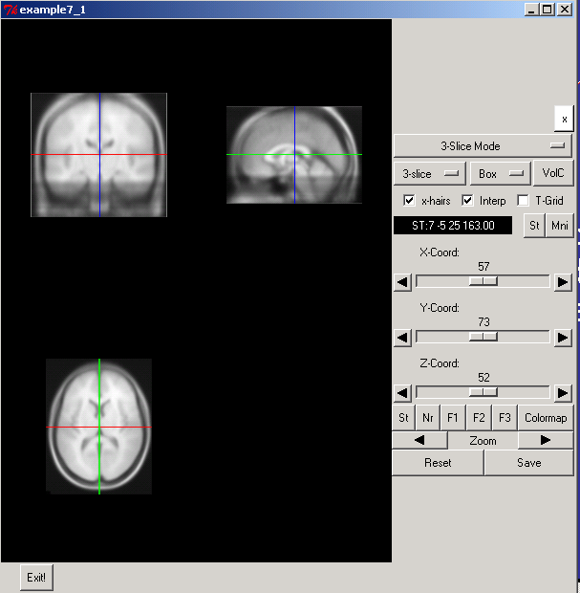
The vtkpxGUIOrthogonalViewer examples\example7_1.tcl

Slide 8
The vtkpxGUIOrthogonalViewer examples\example7_1.tcl
# Step 1
# Append the vtkpxcontrib directory to the package path
lappend auto_path [ file join [ file dirname [ info script ]] vtkpxcontrib ]
# on linux replace with
# lappend auto_path /usr/local/vtk4/brainsuite/base
# Request loading of extension package
package require vtkpxcontrib 1.1
wm geometry . 600x600
frame .top
frame .bottom
pack .bottom -side bottom -expand false -fill x -pady 2 -padx 20
pack .top -side top -expand true -fill both
button .bottom.exit -text "Exit!" -command { destroy . ; exit }
pack .bottom.exit -side left

Slide 9
The vtkpxGUIOrthogonalViewer examples\example7_1.tcl
vtkpxGUIOrthogonalViewer ortho
ortho Initialize .top 1
vtkpxAnalyzeImageSource ana
ana Load mni_305_1.5
vtkpxAnalyzeImageWriter anaw
anaw SetInput [ ana GetOutput ]
anaw SetCompression 6
anaw SetByteSwap 1
anaw Save "copy_of_mni_305_1.5"
# Set Image takes two parameters, the image and the orientation
# Orientation = 0 to 2 (axial=0,coronal=1,sagittal=2)
ortho SetImage [ ana GetOutput ] [ ana GetOrientation ]
ana Delete
vwait forever

Slide 10
Adding Polygonal Data examples\example7_2.tcl
# Append to end of example7_1.tcl
# This Gets the underlying vtkRenderer of the 3D View
set renderer [ [ ortho GetRenderer 3 ] GetRenderer ]
vtkSphereSource sphere
sphere SetRadius 20.0
vtkPolyDataMapper map
map SetInput [ sphere GetOutput ]
vtkActor act
act SetMapper map
[ act GetProperty ] SetColor 1.0 0.0 0.0
$renderer AddActor act
ortho SetDisplayMode3D
vwait forever

Slide 11
The vtkpxGUIMosaicViewer
Complex Component (>3000 lines of C++ Code)
Allows the visualization of multiple image slices of the same orientation
Allows for the use of color maps to map image contrast
Can handle multi-frame images

Slide 12
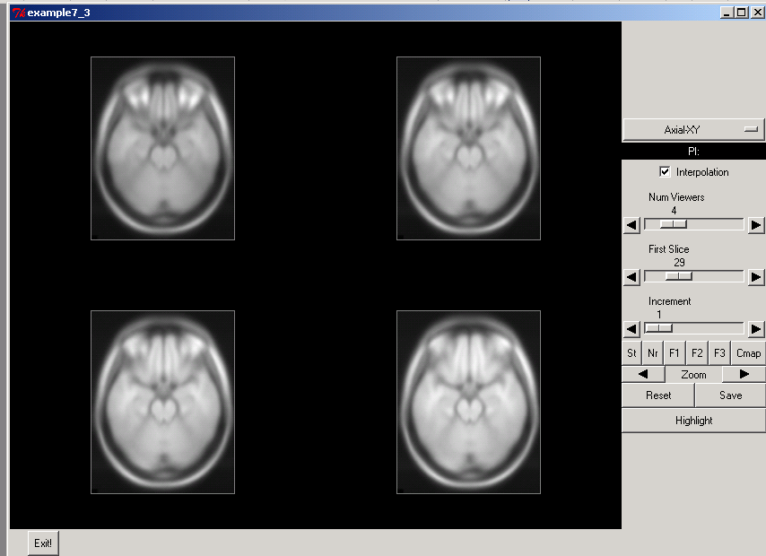
The vtkpxGUIMosaicViewer examples\example7_3.tcl

Slide 13
The vtkpxGUIMosaicViewer examples\example7_3.tcl
In example 7_1 replace
vtkpxGUIOrthogonalViewer ortho
ortho Initialize .top 1
with
vtkpxGUIMosaicViewer mos
mos Initialize .top 1
and
ortho SetImage [ ana GetOutput ] [ ana GetOrientation ]
with
mos SetImage [ ana GetOutput ] [ ana GetOrientation ]

Slide 14
Additional Options – XY Slice Only examples\example7_4.tcl
1. Forcing XY Slice only Display
Replace
vtkpxGUIMosaicViewer mos
mos Initialize .top 1
with
vtkpxGUIMosaicViewer mos
mos SetXYSliceOnly
mos Initialize .top 1

Slide 15
Additional Options – Single Slice Only examples\example7_5.tcl
1. Forcing Single XY Slice only Display
Replace
vtkpxGUIMosaicViewer mos
mos Initialize .top 1
with
vtkpxGUIMosaicViewer mos
mos SetSingleSliceMode
mos Initialize .top 1

Slide 16
Displaying a Multi Frame Image examples\example7_6.tcl
1. Forcing Single XY Slice only Display
Replace
vtkpxGUIMosaicViewer mos
mos Initialize .top 1
vtkpxAnalyzeImageSource ana
ana Load mni_305_1.5
with
vtkpxGUIMosaicViewer mos
mos SetXYSliceOnly
mos Initialize .top 1
vtkpxAnalyzeImageSource ana
ana Load small_heart

Slide 17
Some Comments on Multi-frame Display
Both vtkpxGUIOrthogonalViewer and vtkpxGUIMosaicViewer can be used to display multi-frame images
In each case a fixed number of underlying vtkRenderers is used (4 in the case of vtkpxGUIOrthogonalViewer) with the image input being changed each time the frame is changed.
This does not allow for the addition of different polygonal data to each frame, as in the case of displaying time-varying left-ventricular surfaces embedded in the time-varying image data.
An alternative is the use of vtkpxGUIOrthogonal4DViewer. In this case the number of actual vtkRenderers is 4xNumber of Frames. Hence polygonal data can be added to a frame specific renderer.

Slide 18
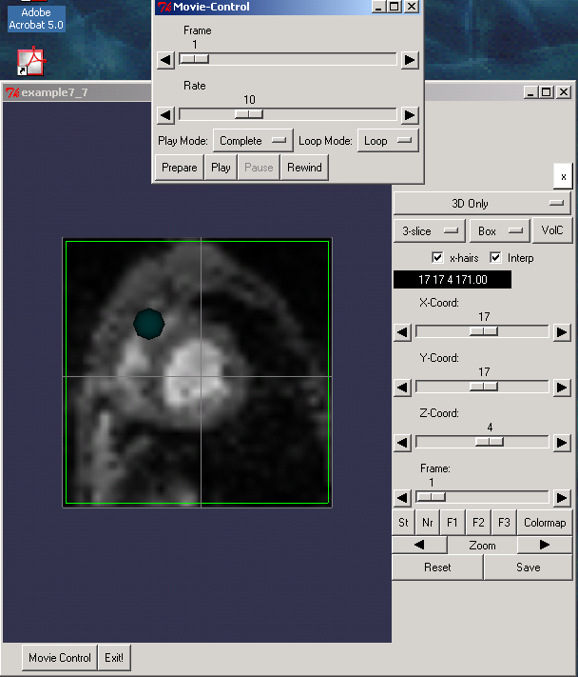
The vtkpxGUIOrthogonal4DViewer examples\example7_7.tcl
Additional
Movie Player
Control

Slide 19
The Underlying GUI examples\example7_7.tcl
# Append the vtkpxcontrib directory to the package path
lappend auto_path [ file join [ file dirname [ info script ]] vtkpxcontrib ]
# Request loading of extension package
package require vtkpxcontrib 1.1
wm geometry . 600x600
frame .top
frame .bottom
pack .bottom -side bottom -expand false -fill x -pady 2 -padx 20
pack .top -side top -expand true -fill both
# Additional dialog to keep movie-player control in
toplevel .movie
wm title .movie "Movie-Control"
wm withdraw .movie
button .bottom.exit -text "Exit!" -command { destroy . ; exit }
button .bottom.movie -text "Movie Control" -command { wm deiconify .movie}
pack .bottom.movie .bottom.exit -side left

Slide 20
Creating the Viewer
vtkpxGUIOrthogonal4DViewer ortho
ortho Initialize .top 1
ortho InitializeMovieControl .movie 1
vtkpxAnalyzeImageSource ana
ana Load small_heart
# Set Image takes two parameters, the image and the orientation
# Orientation = 0 to 2 (axial=0,coronal=1,sagittal=2)
ortho SetImage [ ana GetOutput ] [ ana GetOrientation ]
ana Delete
# Get Number Of Frames
set numframes [ ortho GetNumberOfFrames ]

Slide 21
Adding the Expanding Sphere
for { set i 0 } { $i < $numframes } { incr i } {
set sphere [ vtkSphereSource sphere_$i ]
$sphere SetRadius [ expr $i * 5 + 5 ]
$sphere SetCenter 50.0 50.0 20.0
set mapper [ vtkPolyDataMapper map_$i ]
$mapper SetInput [ $sphere GetOutput ]
set act [ vtkActor act_$i ]
$act SetMapper $mapper
[ $act GetProperty ] SetColor [ expr $i *0.2 ] 0.2 0.2
ortho SetCurrentFrame $i
set ren [ [ ortho GetRenderer 3 ] GetRenderer ]
$ren AddActor $act
$mapper Delete; $sphere Delete; $act Delete
}
ortho SetCurrentFrame $i
ortho SetDisplayMode3D
vwait forever

Slide 22
Extracting a 2D Slice from a 3D Image -- vtkpxImageExtract
vtkpxImageExtract is an Image to Image Filter
Key Functions
  SetInput – determines the input image
  GetOutput – gets the output 2D Slice
  SetSliceNo – sets the slice number to extract
  SetFrame – sets the frame number to extract for 4D Images
  SetCurrentPlane – sets the slice orientation to extract
      0 = YZ, 1=XZ, 2=XY (Default)

Slide 23
Reading Signa LX Images
vtkpxSignaLXReader is derived from vtkpxAnalyzeImageSource
A typical Signa LX Image filenames looks like e3305s1i12
  e3305 is the Patient ID
  s1 is the series number
  i12 is the image (slice) number
To read in a 16 slice acquisition e3305s1i1 to e3305s1i16 use
  vtkpxSignaLXReader sreader
  Sreader Load e3305s1i 1 16

Slide 24
Reading Binary Images
vtkpxAnalyzeImageSource can also be used to read binary images of types char, short and float
vtkpxAnalyzeImageSource ana
ana SetHeaderInfo $width $height $numslices $numframes $swapbytes $numbytes
swapbytes=0,1 whether data needs to be byte-swapped
numbytes=1 for char, 2 for short and 4 for float
ana SetDataOrigin 0.0 0.0 0.0
ana SetDataSpacing $voxelwidth $voxelheight $voxelthickness
ana SetHeaderSize $bytestoskip
this can be used to ignore a number of bytes at the start of the file
ana SetFilePrefix $filename
FilePrefix is a misnomer it should be FileName but …
ana Update

Slide 25
Basic Linear Algebra -- vtkpxMatrix
This is not intended to be a Matlab replacement but some matrix operations are always useful
The LAPACK (Fortran) library is used to perform the more complex operations such as matrix inversion
This is a single-precision matrix (float)
To create a matrix use
  vtkpxMatrix mat
To set/reset its size use
  mat Zeros 4 5
  mat Ones 9 11
  mat Eye 5

Slide 26
Basic Linear Algebra – vtkpxMatrix examples\example7_10.tcl
To set/get individual element values (0-offset) use
  mat SetElement $row $column $value
  set value [ mat GetElement $row $column ]
  SetElement/GetElement do range checking you can also use SetDirectElement/GetDirectElement to avoid this for speed!
Lots of other operations
  scaling, addition, multiplication, inversion
  QR decomposition, linear system equation solution
  Least squares solution etc
  See example script for more examples etc

Slide 27
This completes Part 1

Slide 28
Tentative Syllabus – Part 2
C++ Fundamentals, Pointers/Classes
Object Oriented Programming
Adding new VTK Commands/Cmake
More on Images and Surfaces
Case Study I – Computing t-maps in fMRI
Case Study II -- Iterative Closest Point surface matching
Case Study III – Linear Mutual Information Multimodal Registration

Slide 29
Possible Options for Part II
Not Teach it Al!
Start after Thanksgiving break.
Start in January with the semester
Do it as a crash course early January (i.e. before the semester starts)
Other ??
In the meantime (for options 2-5) get a C++ book and start reading, I will expect some familiarity with at least intro C/C++

